Slide 1
Data Science Capstone Project PPT Instructor : Sir Alex Aklson , Senior Data Scientist at IBM Made by : Rishi Kumar
Project Topic : The Battle Neighborhood on Exploring Zomato restaurants datasets in New Delhi City

Slide 2
Introduction
The City New Delhi is the capital of India that contains population of more than 257,803 . However the much larger area has a population that exceeds 26 Million .
With its diverse culture and tradition the city has multiple varieties of food items such as cuisine food item . There are huge number of restaurants of Chinese , French and Italian .
As per project we will analyze data and visualize the locations and different restaurants area in the New Delhi City .

Slide 3
Objectives
We are basically find the answers of the following questions :
What is best location in New Delhi City for Chinese Cuisine ?
Which areas have large number of Chinese Restaurant Market ?
Which all areas have less number of restaurant ?
Which is the best place to stay if I prefer Chinese Cuisine ?
What places are have best restaurant in New Delhi?

Slide 4
About Data
For this project we need the following data :
New Delhi Restaurants data that contains list Locality, Restaurant name , Rating along with their latitude and longitude.
Data source : Zomato kaggle dataset
Description : This data set contains the required information. And we will use this data set to explore various locality of New Delhi city.
Nearby places in each locality of New Delhi city.
Data source : Fousquare API
Description : By using this API we will get all the venues in each Neighborhood .

Slide 5
Approach
Collect the New Delhi city data from Zomato kaggle dataset
Using FourSquare API we will find all venues for each Neighborhood.
Filter out all venues that are nearby by locality.
Using aggregative rating for each restaurant to find the best places.
Visualize the Ranking of Neighborhood’s using folium library(python) .

Slide 6
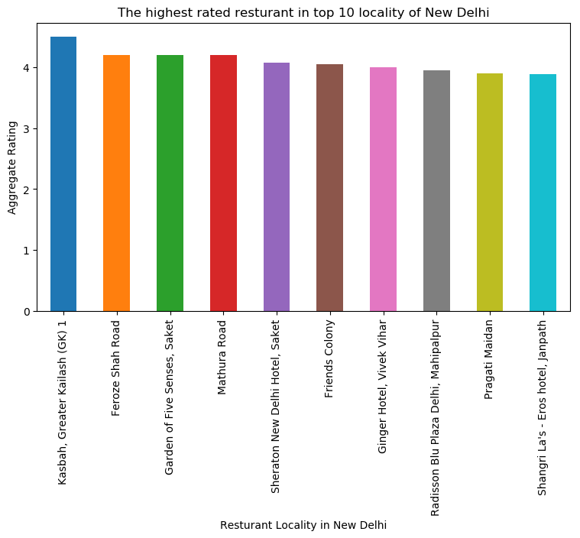
Result
We demonstrate the following results in the charts and in the dataset forms .

Slide 7
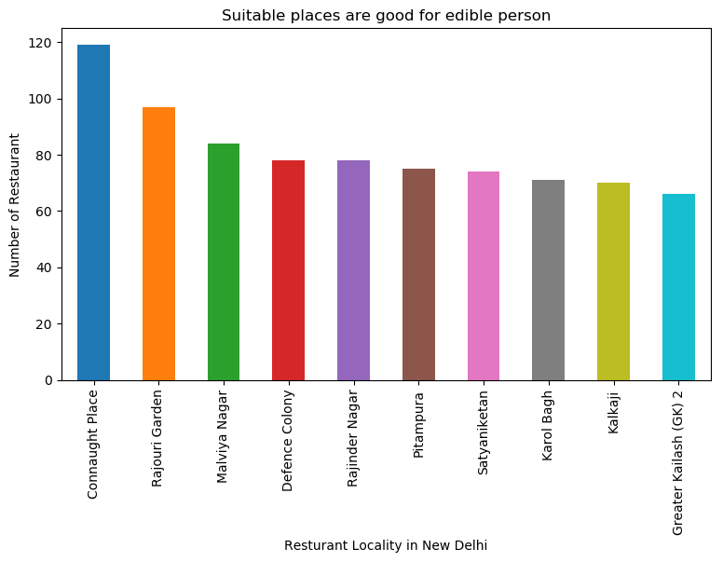

Slide 8
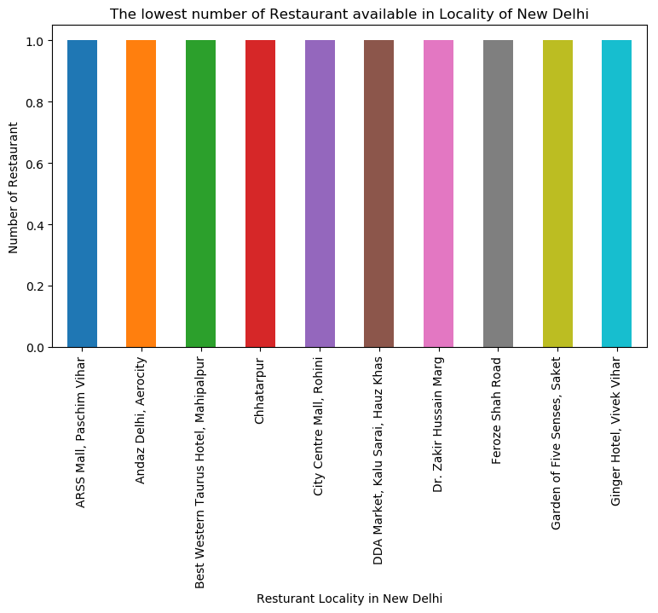

Slide 9
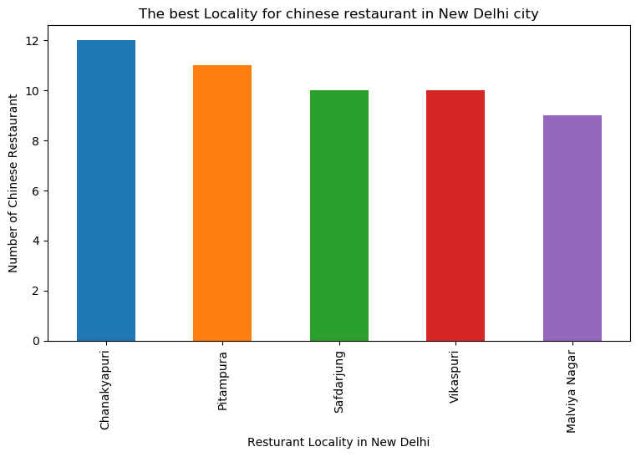

Slide 10
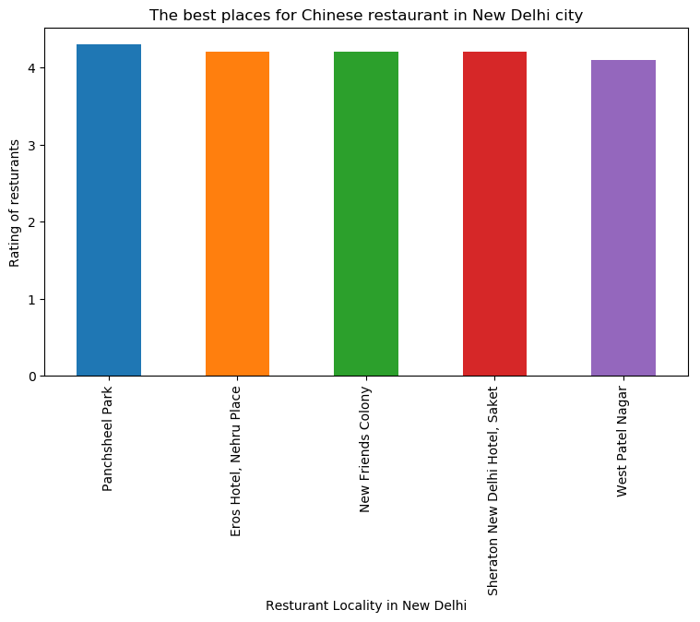

Slide 11


Slide 12
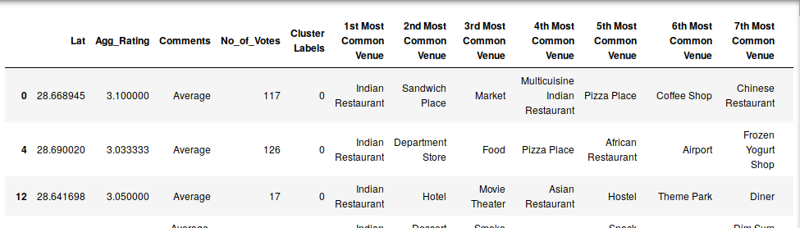
Cluster 1
The Indian Restaurants are most recommended venues in near by location .

Slide 13
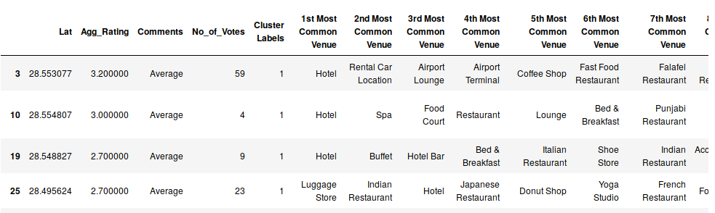
Cluster 2
It is recommended for the Hotels and Night clubs areas .

Slide 14
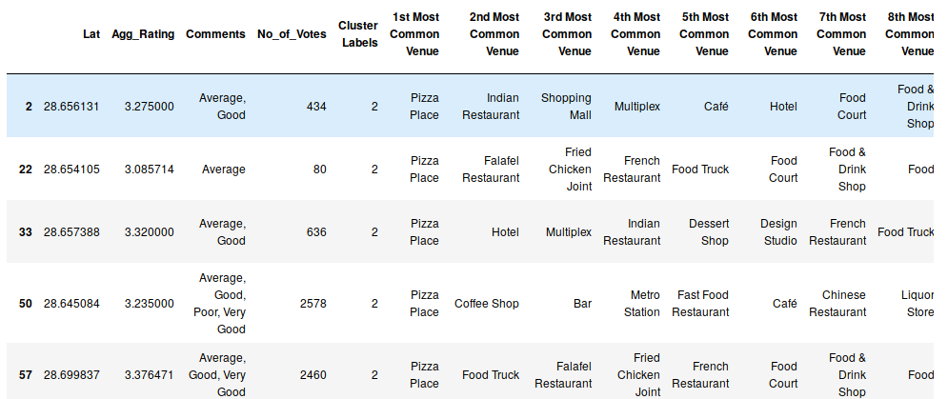
Cluster 3
The places for Pizzas location

Slide 15
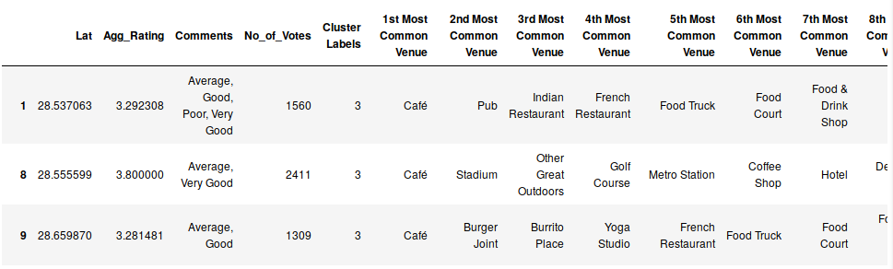
Cluster 4
It is most recommended for Cafes .

Slide 16
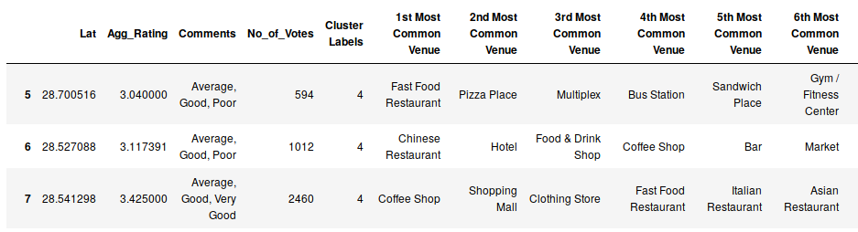
Cluster 5
Fast food and Cafes are the most recommended Places .

Slide 17
Conclusions
Chanakyapuri, Pitampura, Safdarjung are some of the best Neighborhood for Chinese cuisine.
Pancsheel park, Nehru place have the best Chinese Resturant.
Cannaught place, Rajouri garden, Malviya nagar are the best places for edible person.
Greater kailash, Feroze shah road, Saket have best resturants in New Delhi.
Cluster 1: It is most recommended for Indian Restaurants.
Cluster 2: It is most recommended for Hotels and nightclub.
Cluster 3 and Cluster 5: It is most recommended for Fast food.
Cluster 4: It is most recommended for the cafe and pizza

